Slide 1


Dark Web Scraper
By: omri zilberstein

Slide 2


Goals
Scrape a site on the dark web for data
Create a user interface
Create a Rest API server
Show analytics and stats about the scraped data
Show the status of the scraper
Create 2 organized and manageable DB’s
Show alerts when new data is added
Micro-services

Slide 3

Technologies
Rest API server : NodeJS
Client: ReactJS
Scraper: Python
DB’s: Elasticsearch, MongoDB (cloud)
Docker

Slide 4

Challenges
Python
Selenium
Docker
Analytics
Responsive
One source of truth
Duplicates

Slide 5

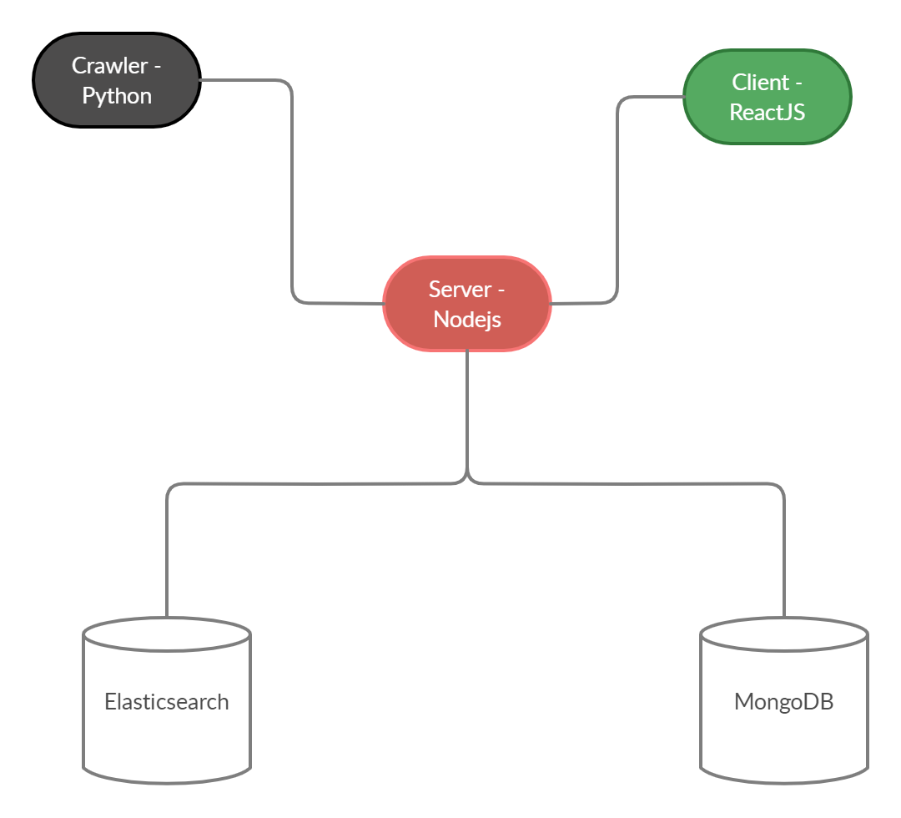


Architecture

Slide 6
Docker
Tor / Proxy
Elasticsearch
Server – Rest API
Webscraper

Slide 7
Scraper
HTTP Request / Selenium (locally)
Configurable: Keywords, URL, Cooldown…
Constantly scrapes

Slide 8
Server
Rest API
NodeJS
User, Data entry points
Logic and data analytics

Slide 9
Client
ReactJS
Responsive
Data visualization
Scraper status
Alerts

Slide 10
Databases
MongoDB – User data
Elasticsearch – Bins data

